Slide 1

CNT Tutorial 2
Nachiket Kulkarni

Slide 2
RECAP

Slide 3
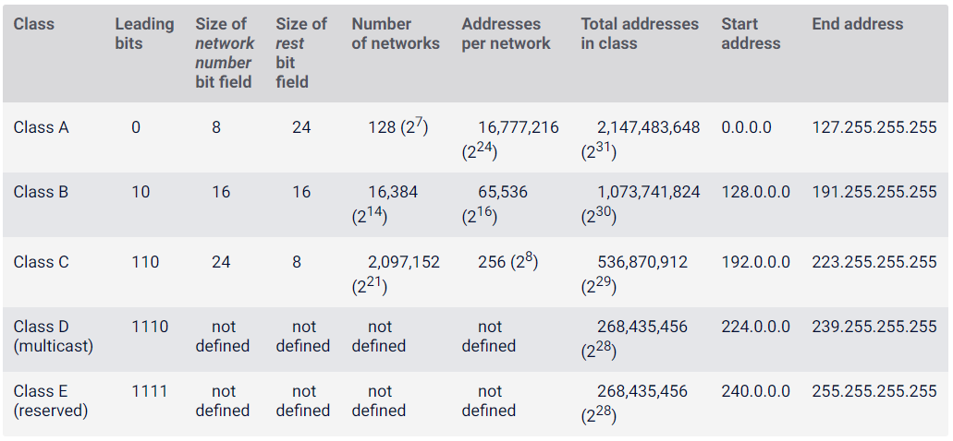
IPv4 Address Structure

Slide 4
Disadvantages of Classful Addressing
Wastage of IP addresses
No flexibility
Maintenance is a headache
Security management is difficult

Slide 5
Solution?
Classless Addressing
Introduced in 1993
No classes, only blocks
Managed by IANA ie. Internet Assigned Number Authority

Slide 6
Classless Addressing
Divided into two part similar to classful addressing
Denoted as “x.y.z.t/n”
Example: 150.100.20.50/28
Block ID
Host ID
32 bits

Slide 7
Classless Addressing
What is the network ID?
Use masks
Example:
IP address: 150.100.20.50/28
Mask: 11111111. 11111111. 11111111.11110000 ie. 255.255.255.240
Ans: 150.100.20.48/28

Slide 8
Classless Addressing
Rules for assigning blocks:
Rule 1: the addresses should be contiguous.
Rule 2: Number of addresses in a block must be power of 2
Rule 3: First address of every block must be evenly divisible by size of the block
In our case, the first address is 150.100.20.48. This is divisible by the size of the block which is 16
Special Note: In classless addressing, the last address in the block does not necessarily end in 255.

Slide 9
Example 1
Which of the following can be the beginning address of a block that contains 16 addresses?
a. 205.16.37.32 b.190.16.42.44 c. 17.17.33.80 d.123.45.24.52

Slide 10
Example 1
Which of the following can be the beginning address of a block that contains 16 addresses?
a. 205.16.37.32 b.190.16.42.44 c. 17.17.33.80 d.123.45.24.52
Solution Only two are eligible (a and c). The address 205.16.37.32 is eligible because 32 is divisible by 16. The address 17.17.33.80 is eligible because 80 is divisible by 16.

Slide 11
Example 2
Which of the following can be the beginning address of a block that contains 256 addresses?
a.205.16.37.32 b.190.16.42.0 c.17.17.32.0 d.123.45.24.52

Slide 12
Example 2
Which of the following can be the beginning address of a block that contains 256 addresses?
a.205.16.37.32 b.190.16.42.0 c.17.17.32.0 d.123.45.24.52
Solution In this case, the right-most byte must be 0. As we mentioned in Chapter 4, the IP addresses use base 256 arithmetic. When the right-most byte is 0, the total address is divisible by 256. Only two addresses are eligible (b and c).

Slide 13
Example 3
Which of the following can be the beginning address of a block that contains 1024 addresses?
a. 205.16.37.32 b.190.16.42.0 c. 17.17.32.0 d.123.45.24.52

Slide 14
Example 3
Which of the following can be the beginning address of a block that contains 1024 addresses?
a. 205.16.37.32 b.190.16.42.0 c. 17.17.32.0 d.123.45.24.52
Solution In this case, we need to check two bytes because 1024 = 4 × 256. The right-most byte must be divisible by 256. The second byte (from the right) must be divisible by 4. Only one address is eligible (c).

Slide 15
Masks
In classful addressing, the mask for each block is implicit
255.0.0.0/8
255.255.0.0/16
255.255.255.0/24
In classless addressing, we need the address and the mask to find the block the address belongs to

Slide 16
Masks
Write down masks for
/1
/6
/15
/24
/31

Slide 17
Masks
What is the first address in the block if one of the addresses is 167.199.170.82/27?

Slide 18
Masks
What is the first address in the block if one of the addresses is 167.199.170.82/27?
Solution The prefix length is 27, which means that we must keep the first 27 bits as is and change the remaining bits (5) to 0s. The following shows the process:
Address in binary: 10100111 11000111 10101010 01010010 Keep the left 27 bits: 10100111 11000111 10101010 01000000 Result in CIDR notation: 167.199.170.64/27

Slide 19
Masks
What is the first address in the block if one of the addresses is 140.120.84.24/20?

Slide 20
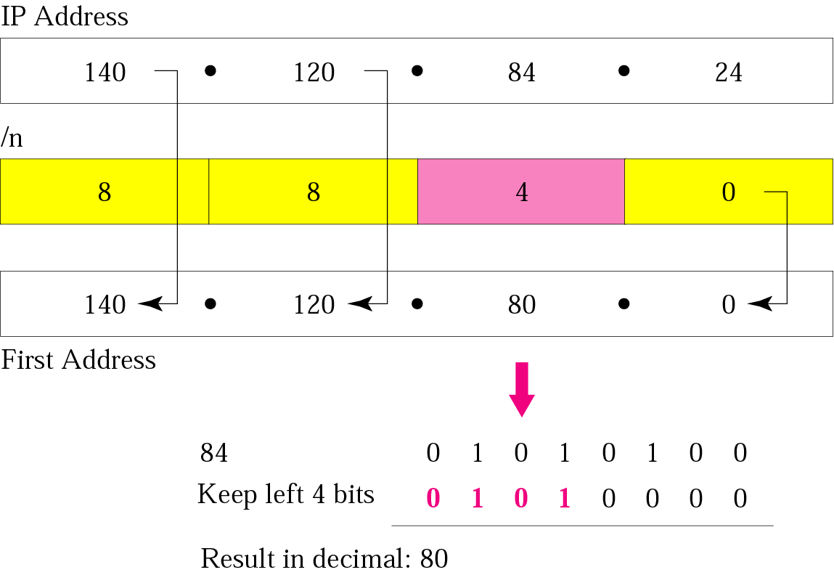
Masks
What is the first address in the block if one of the addresses is 140.120.84.24/20?
140.120.80.0/20.

Slide 21
Masks
Find the number of addresses in the block if one of the addresses is 140.120.84.24/20.

Slide 22
Masks
Find the number of addresses in the block if one of the addresses is 140.120.84.24/20.
Solution The prefix length is 20. The number of addresses in the block is 2³²⁻²⁰ or 2¹² or 4096.
Note that this is a large block with 4096 addresses.

Slide 23
Masks
Find the last address in the block if one of the addresses is 140.120.84.24/20.

Slide 24
Masks
Find the last address in the block if one of the addresses is 140.120.84.24/20.
Solution We found in the previous examples that the first address is 140.120.80.0/20 and the number of addresses is 4096. To find the last address, we need to add 4095 (4096 − 1) to the first address.

Slide 25
To keep the format in dotted-decimal notation, we need to represent 4095 in base 256 (see Appendix B) and do the calculation in base 256. We write 4095 as 15.255. (256 divides into 4095 15 times with a remainder of 255.) We then add the first address to this number (in base 255) to obtain the last address as shown below:
140 . 120 . 80 . 0 15 . 255 ------------------------- 140 . 120 . 95 . 255
The last address is 140.120.95.255/20.

Slide 26
Masks
Simple example:
Find the block if one of the addresses is 190.87.140.202/29.
Show a network configuration for the block.

Slide 27
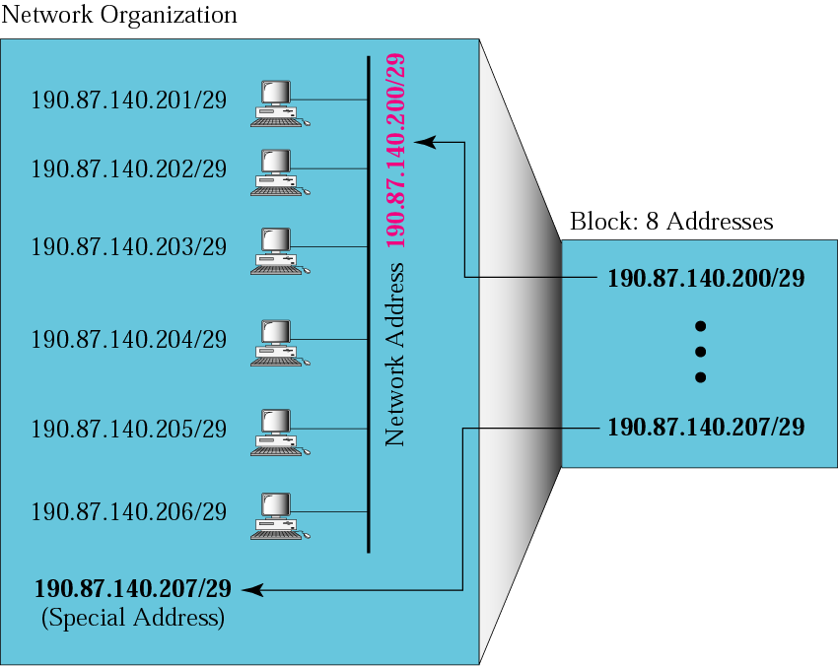
Masks

Slide 28
Subnet
Introduced during the era of classful addressing
Divide network into smaller subnetworks
Done internally by the organization
Each subnet gets its own network admin
Better security management

Slide 29
Subnet
How to do it?

Slide 30

Subnet
S1
S2
Simple case of 2 subnets
Network ID is 200.120.170.0
Default mask is 255.255.255.0
Host starts from 200.120.170.0 to 200.120.170.255
200.120.170._ _ _ _ _ _ _ _
Class C:
200.120.170.0

Slide 31
Subnet
S1
S2
Subnet 1: 200.120.170.0 _ _ _ _ _ _ _
Subnet 2: 200.120.170.1 _ _ _ _ _ _ _
Class C:
200.120.170.0

Slide 32
Subnet
S1
S2
Range for Subnet 1: 200.120.170.0 0 0 0 0 0 0 0 TO 200.120.170.0 1 1 1 1 1 1 1 ie. 200.120.170.0 TO 200.120.170.127
200.120.170.0 defines the subnet
200.120.170.127 is broadcast address
Usable hosts: 128-2 = 126
Class C:
200.120.170.0

Slide 33
Subnet
S1
S2
Range for Subnet 2: 200.120.170.1 0 0 0 0 0 0 0 TO 200.120.170.1 1 1 1 1 1 1 1 ie. 200.120.170.128 TO 200.120.170.255
200.120.170.128 defines the subnet
200.120.170.255 is broadcast address
Usable hosts: 128-2 = 126
Class C:
200.120.170.0

Slide 34
Subnet
S1
S2
Because of subnetting, available host addresses are reduced
Without subnetting: 256-2 = 254
With subnetting: Subnet 1: 128-2=126 Subnet 2: 128-2=126 Total: 126+126 = 252
Class C:
200.120.170.0

Slide 35
Subnet
S1
S2
How do we know where the message intended for 200.120.170.34 will go?
Will it go to S1?
Will it go to S2?
Internal router to decide this
Class C:
200.120.170.0

Slide 36
Subnet
S1
S2
Internal router to decide this
Mask for this subnet: 255.255.255.1 0 0 0 0 0 0 0 ie. 255.255.255.128
How does this work?
200.120.170.34 AND 255.255.255.128 34: 0010 0010 128: 1000 0000 Ans: 0000 0000 ie. 200.120.170.0
This is the network id for S1
Class C:
200.120.170.0

Slide 37
Subnet
S1
S2
How about 200.120.170.150
200.120.170.150 AND 255.255.255.128 150: 1001 0110 128: 1000 0000 Ans: 1000 0000 ie. 200.120.170.128
This is the network id for S2
Class C:
200.120.170.0

Slide 38
Subnet
S1
S2
200.120.170.0 is network ID
200.120.170.0 is also subnet ID for S1
Is it confusing?
No! As far as outside world is concerned, 200.120.170.0 corresponds to the network
Once the packet is inside the network, 200.120.170.0 represents subnet.
Class C:
200.120.170.0

Slide 39
Subnet
Divide class C network 192.250.122.0 into 4 subnets
Write down host capacity of the network
Write subnet id and broadcast id of each subnet
Write subnet mask for each subnet

Slide 40
Subnet
For a class C network 192.120.33.0, the subnet mask is 255.255.255.224
How many subnets are there?
How many hosts can be connected to this network?
What are the broadcast addresses of each subnet?

Slide 41
Subnet
For a class B network 172.12.0.0, the subnet mask is 255.255.128.0
How many subnets are there?
How many hosts can be connected to this network?
What are the broadcast addresses of each subnet?

Slide 42
Subnet
What if the subnet sizes are different
Instead of dividing the network in 4 equal sized subnets, we want to divide it in 3 subnets
First subnet is half the size of the block
2nd and 3rd subnets are 1/4th the size of the block
This is called variable length subnet

Slide 43
Subnet
Consider following address: 192.168.50.0
Divide this network into the subnets as described before
Subnet ID for
S1: 192.168.50.00000000 ie. 192.168.50.0 Mask: 255.255.255.128
S2: 192.168.50.10000000 ie. 192.168.50.128 Mask: 255.255.255.192
S3: 192.168.50.11000000 ie. 192.168.50.192
Mask: 255.255.255.192
S1
S2
S3

Slide 44
Subnet
Use the same logic for Classless Addressing for the following question:
An organization is granted the block 130.34.12.64/26. The organization needs 4 subnets. What is the subnet prefix length?

Slide 45
Subnet
Use the same logic for Classless Addressing for the following question:
An organization is granted the block 130.34.12.64/26. The organization needs 4 subnets. What is the subnet prefix length?
Solution We need 4 subnets, which means we need to add two more 1s (log₂ 4 = 2) to the site prefix. The subnet prefix is then /28.

Slide 46
Subnet
What are the subnet addresses and the range of addresses for each subnet in the previous example?

Slide 47
Subnet
What are the subnet addresses and the range of addresses for each subnet in the previous example?
1. The first address in the first subnet is 130.34.12.64/28, using the procedure we showed in the previous examples. Note that the first address of the first subnet is the first address of the block. The last address of the subnet can be found by adding 15 (16 −1) to the first address. The last address is 130.34.12.79/28.

Slide 48
Subnet
2.The first address in the second subnet is 130.34.12.80/28; it is found by adding 1 to the last address of the previous subnet. Again adding 15 to the first address, we obtain the last address, 130.34.12.95/28.
3. Similarly, we find the first address of the third subnet to be 130.34.12.96/28 and the last to be 130.34.12.111/28.
4. Similarly, we find the first address of the fourth subnet to be 130.34.12.112/28 and the last to be 130.34.12.127/28.

Slide 49
Subnet
An organization is granted a block of addresses with the beginning address 14.24.74.0/24. There are 2³²⁻²⁴= 256 addresses in this block. The organization needs to have 11 subnets as shown below:
a. two subnets, each with 64 addresses.
b. two subnets, each with 32 addresses.
c. three subnets, each with 16 addresses.
d. four subnets, each with 4 addresses.
Design the subnets.

Slide 50
Network Address Translation (NAT)
Number of devices connected to internet is ever increasing
Shortage of addresses
Solution: NAT
NAT enables a user to have a large set of addresses internally and one address, or a small set of addresses, externally
The traffic inside can use the large set; the traffic outside, the small set

Slide 51
Network Address Translation (NAT)
Private IP network is an IP network that is not directly connected to the Internet
IP addresses in a private network can be assigned arbitrarily
Not registered and not guaranteed to be globally unique
Generally, private networks use addresses from the following address ranges (non-routable addresses):
10.0.0.0 – 10.255.255.255
172.16.0.0 – 172.31.255.255
192.168.0.0 – 192.168.255.255

Slide 52
Network Address Translation (NAT)

Slide 53
Network Address Translation (NAT)
All the outgoing packets go through the NAT router, which replaces the source address in the packet with the global NAT address
All incoming packets also pass through the NAT router, which replaces the destination address in the packet (the NAT router global address) with the appropriate private address

Slide 54
Network Address Translation (NAT)
NAT device has address translation table
One to one address translation

Slide 55
Network Address Translation (NAT)
NAT is a way to conserve IP addresses
Can be used to hide a number of hosts behind a single IP address
NAT is a router function where IP addresses (and possibly port numbers) of IP datagrams are replaced at the boundary of a private network
NAT is a method that enables hosts on private networks to communicate with hosts on the Internet
NAT is run on routers that connect private networks to the public Internet, to replace the IP address-port pair of an IP packet with another IP address-port pair

